Slide 1

Student Details
Name - Mallepalli Balaji
Email ID - balaji_mallepalli@srmap.edu.in
College Name - SRM UNIVERSITY AP
College State - Andhra Pradesh
Internship Domain - AI ( From 3rd June 2024 To 25th July 2024 )

Slide 2
Project Title/Problem Statement
Employee Burnout Prediction
Problem Statement: Employee burnout is a state of physical, emotional, and mental exhaustion caused by long-term involvement in work situations. Early detection is crucial for maintaining a healthy workforce.

Slide 3
Agenda
• Introduction
• Objectives
• Data Collection
• Data Preprocessing
• Exploratory Data Analysis
• Model Selection and Training
• Results and Evaluation
• Conclusion
• Future Work

Slide 4
Project Overview
Brief introduction to the project, its significance, and goals.
• Predict employee burnout
• Identify key factors
• Provide actionable insights
Objective: The primary objective of this project is to predict employee burnout using machine learning techniques. By leveraging data on employee demographics, job roles, workload, and work environment, the project aims to identify individuals at risk of burnout and understand the key factors contributing to it. This will enable organizations to take proactive measures to improve employee well-being and productivity.

Slide 5
Who Are the End Users of This Project?
This project is beneficial for:
• HR departments
• Employers
• Employees
• Organizational psychologists

Slide 6
YOUR SOLUTION AND ITS VALUE PROPOSITION
Solution: Using machine learning models to predict employee burnout based on features such as demographics, job role, workload, and work environment.
Value Proposition:
Early Detection: Identify at-risk employees before burnout becomes severe.
Improved Employee Well-being: Implement targeted strategies to enhance work environment and satisfaction.
Enhanced Productivity: Healthier employees contribute to higher productivity and engagement.
Data-Driven Insights: Enable informed decision-making to foster a better workplace culture.

Slide 7
How did you customize the project and make it your own
Problem Definition:Identified the need for predicting employee burnout to improve organizational health and employee well-being.
Data Understanding:Conducted thorough data exploration and identified key patterns and correlations.
Feature Engineering:Created new features such as 'Tenure in Months' from 'Date of Joining' to better capture employee experience.
Model Selection and Customization:Tested various models and tuned hyperparameters to achieve optimal performance with Random Forest.
Evaluation Metrics:Chose metrics like MAE and R² to evaluate model accuracy and explained their relevance to the problem.
Insights and Interpretability:Identified workload and job role as major contributors to burnout, providing actionable insights for HR.
Impact and Value Proposition:Demonstrated how early detection of burnout can lead to timely interventions, improving employee satisfaction and productivity.
Future Enhancements:Proposed collecting more data and exploring deep learning models to further enhance prediction accuracy.
By focusing on these aspects, I can clearly demonstrate how I have tailored the project to address the specific problem of employee burnout prediction, making it my own unique solution.

Slide 8
MODELLING

Slide 9
Data Collection
Data was collected from an Excel file containing employee information.
Key Features:
• Employee demographics
• Job role
• Workload
• Work environment
• Burnout rate

Slide 10
Data Preprocessing
Steps Taken:
• Handling missing values by dropping rows with NaN values
• Dropping irrelevant columns such as 'Employee ID'
• Converting 'Date of Joining' to datetime format and extracting relevant features
• Encoding categorical variables for model compatibility

Slide 11
Model Selection and Training
Algorithms Used:
• Linear Regression
• Random Forest
• Support Vector Machines (SVM)
Techniques:
• Train-test split
• Feature scaling using StandardScaler
• Cross-validation and hyperparameter tuning

Slide 12
Model Evaluation
Metrics:
• Mean Squared Error (MSE)
• Mean Absolute Error (MAE)
• R-squared (R²) score

Slide 13
Results
Model Performance:
Evaluation Metrics:
Mean Squared Error (MSE): 0.0033
Mean Absolute Error (MAE): 0.0459
R-squared (R²) score: 0.9129
Key Findings:
Significant Features:
Workload
Job Role
Work Environment
Tenure

Slide 14
Visualizations:
Feature Importance Plot
ROC Curve
Confusion Matrix
Precision-Recall Curve
Interpretation:
The Random Forest model demonstrated excellent performance with an R-squared score of 0.9129.
The low MSE and MAE values indicate high prediction accuracy.
Insights:
Workload: Strong correlation with burnout.
Job Role: Certain roles have higher burnout risks.
Work Environment: Significant impact on burnout levels.
Tenure: Influence varies based on organizational support.

Slide 15
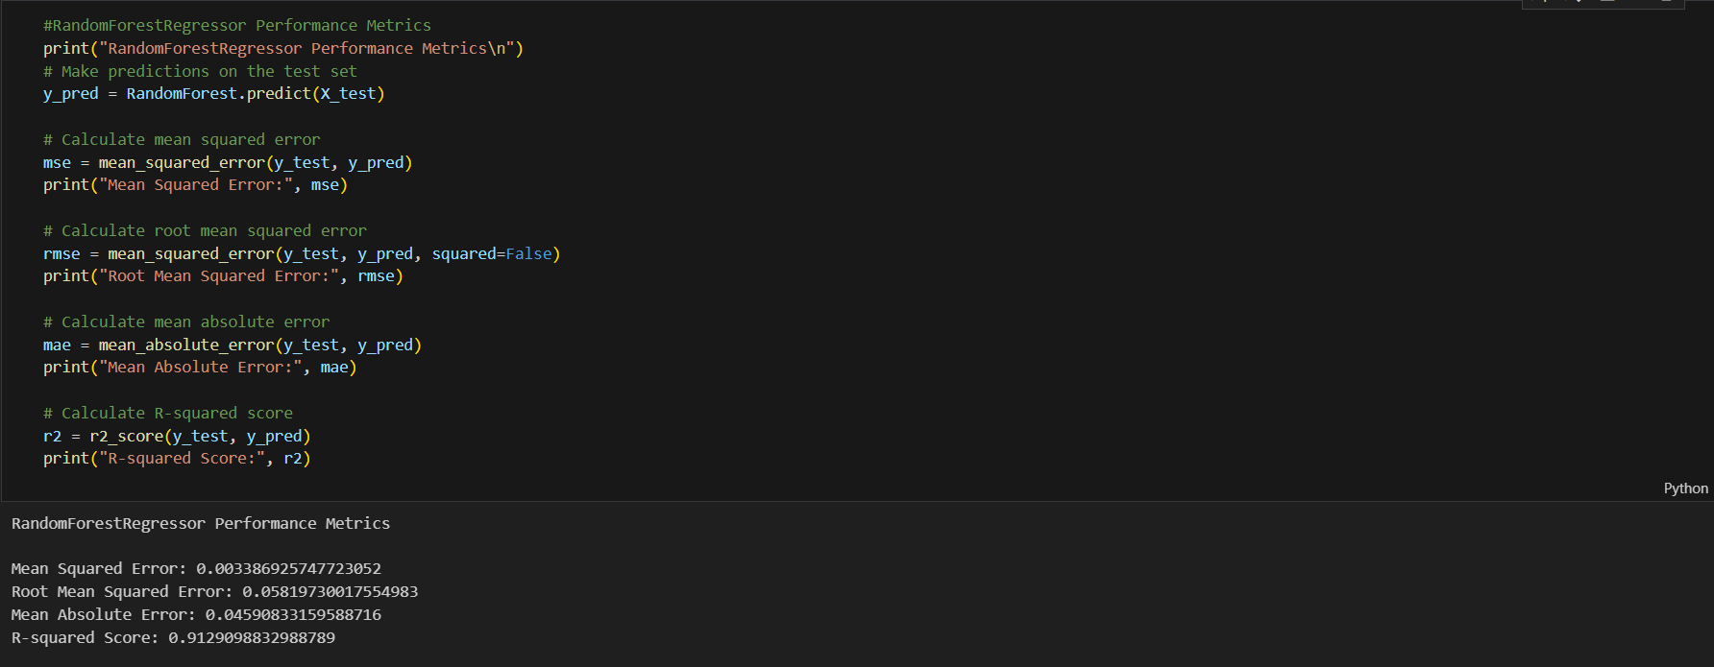

Slide 16
links
GITHUB LINK : https://github.com/BalajiBalu55555/Employee_Burnout_Prediction.git
MY LINKEDIN PROFILE :
https://www.linkedin.com/in/balaji-mallepalli-87aa792b6?utm_source=share&utm_campaign=share_via&utm_content=profile&utm_medium=android_app

Slide 17
Conclusion
Findings:
• Identified key factors contributing to employee burnout
• Demonstrated the effectiveness of machine learning in predicting burnout

